Slide 1
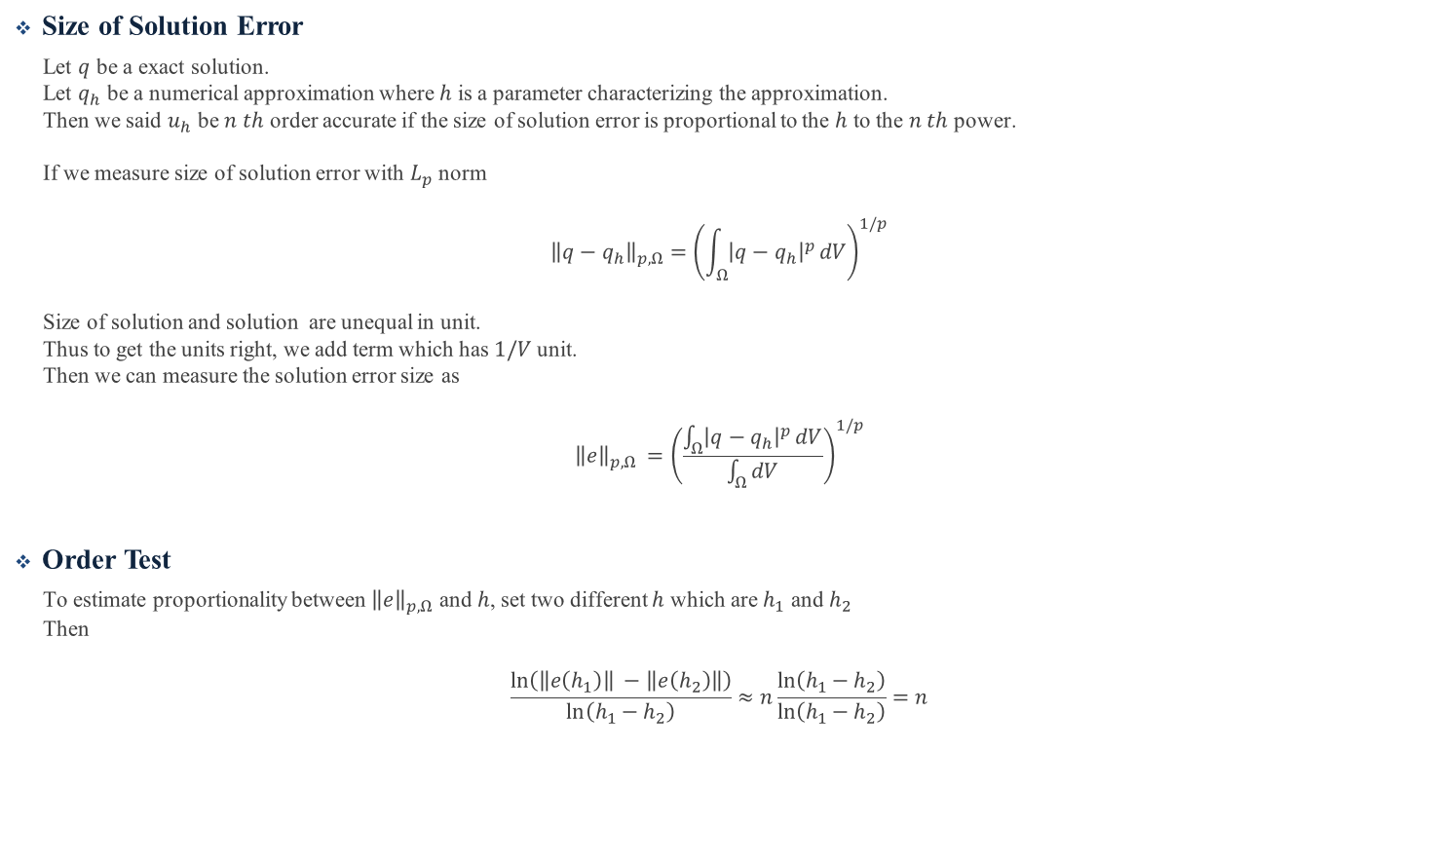
Size of Solution Error
Let $q$ be a exact solution.
Let $q_{h}$ be a numerical approximation where $h$ is a parameter characterizing the approximation.
Then we said $u_{h}$ be $n th$ order accurate if the size of solution error is proportional to the $h$ to the $n th$ power.
If we measure size of solution error with $L_{p}$ norm
$${\left\|q−q_{h}\right\|}_{p,Ω}={\left(\int_{Ω}{{\left|q−q_{h}\right|}^{p}}dV\right)}^{1/p}$$
Size of solution and solution are unequal in unit.
Thus to get the units right, we add term which has $1/V$unit.
Then we can measure the solution error size as
$${\left\|e\right\|}_{p,Ω }={\left(\frac{\int_{Ω}{{\left|q−q_{h}\right|}^{p}}dV}{\int_{Ω}{dV}}\right)}^{1/p}$$
Order Test
To estimate proportionality between ${\left\|e\right\|}_{p,Ω}$ and $h$, set two different $h$ which are $h_{1}$ and $h_{2}$
Then
$$\frac{\ln\left(\left\|e\left(h_{1}\right)\right\| −\left\|e\left(h_{2}\right)\right\|\right)}{\ln\left(h_{1}−h_{2}\right)}≈n\frac{\ln\left(h_{1}−h_{2}\right)}{\ln\left(h_{1}−h_{2}\right)}=n$$
Notes:
https://en.wikipedia.org/wiki/Order_of_accuracy

